Slide 1
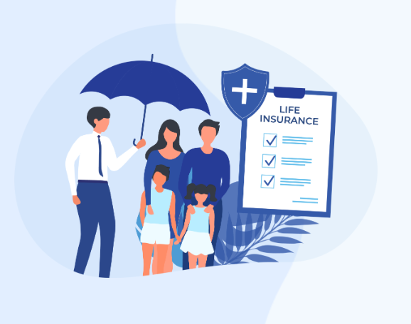


PowerPoint Infographics Sampler
KlarifyLife Term Guide Consumer Behaviour Live Project
NAME: HEETA PARMAR
COURSE: MSC STATISTICS AND DATA SCIENCE(MSC SDS)

Slide 2
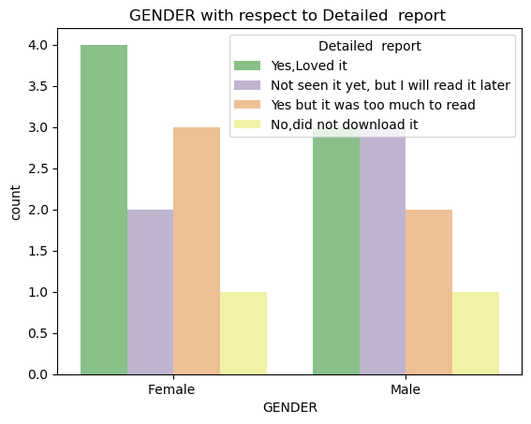
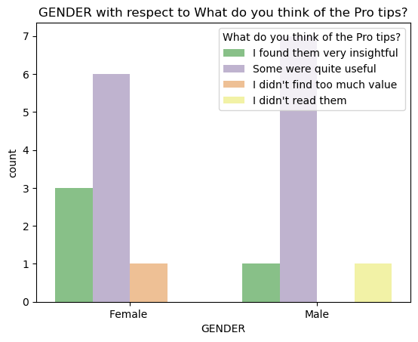
Sample 4
GENDER WISE ANALYSIS
Males
Females
Most of the males are exploring the idea of buying term insurance .
Most of the females are umware about the their term insurance
e
.
%
Variable Two
47.3%
are males .
52.63%
are females
Some of them found the term guide language could have been better

Slide 3
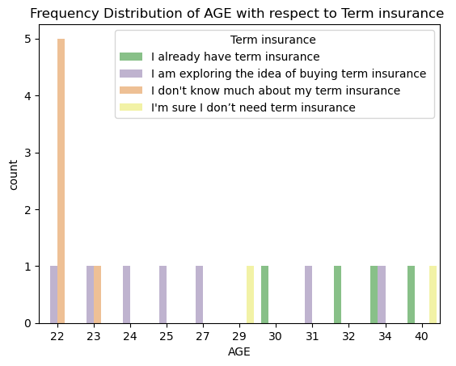
Sample 1
What age group needs to be targeted ?
Maximum observation are from Pune City where most of them are Salaried profession
People of age group 22-23 are still unaware of their term insurance .But mostly after the age of 30 people have their term insurance. So basically 22-30 yrs is the main age group we can target.
Salaried profession person and Entrepreneur are looking for to buy the term life insurance
A
B
C
94%
People found the term life insurance language was simple and jargon free .
50%
It’s a 50 -50 chance of people buying the term insurance and people thinking to buy but are not sure
The age group of 22 years did not pay attention to the pro tips
Category 1
Category 2
Category 3
Category 4
Category 5
Category 6

Slide 4
Sample 2
Summary Report :
22 years
Do not read everything (pro tips)
Salaried profession
Place Are willing to buy the insurance insurance
Males
Are looking forward to buy the insurance .
22 years
The main target group
Term guide was useful for everyone
Females
If the term life insurance is introduced to females at the age of 22 they are more likely of buying it as compared to males .
Pune city had most observation
80%
Read the report and loved it .

Slide 5

THANK YOU>>>

